Slide 1
Astro 331 Lesson 19
Electrical Power Subsystem (EPS)
SMAD Ch 5.1, 11.4, Supp Crs Mtl

Slide 2
Lesson Objectives
Explain spacecraft power functions
List and describe typical system-level parameters that impact power subsystem design
List and describe common spacecraft power sources
Explain what a I-V plot of a planar array describes, and how temperature changes the I-V curve
Calculate solar array area to support a space mission
Understand how depth of discharge of a battery impacts the cycle life of a secondary battery
Calculate battery capacity to support a space mission
Calculate the beta angle for an orbit and understand its importance when calculating eclipse duration

Slide 3
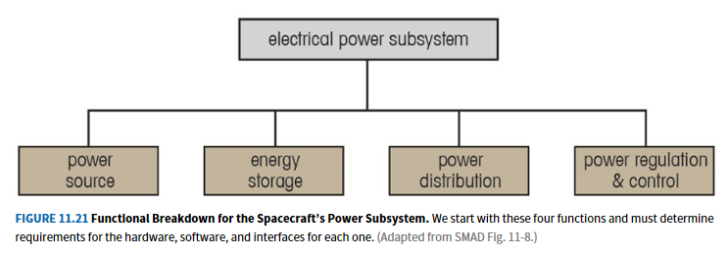

Slide 4
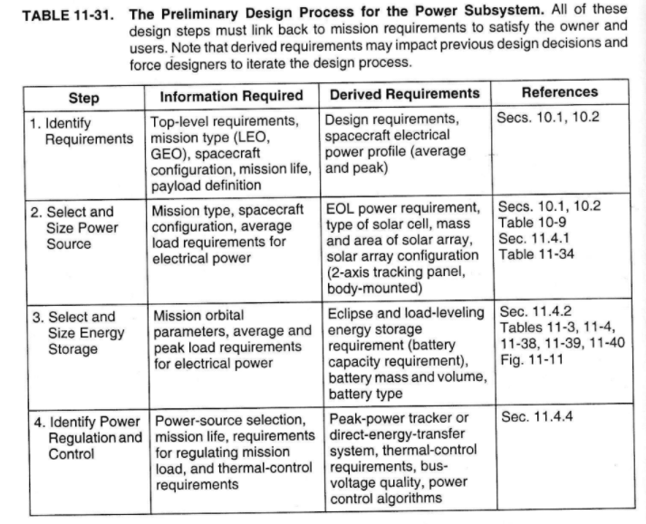

Slide 5
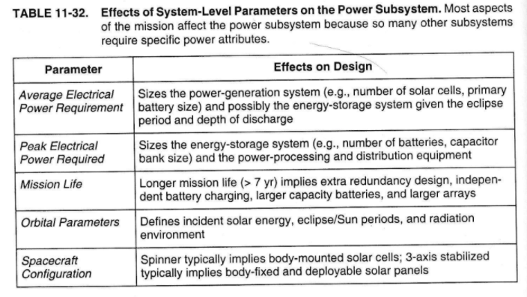

Slide 6
Spacecraft Power Sources (1/2)
Photovoltaic
converts incident solar radiation to electrical energy
15%-30% efficient (varies based on solar cell technology)
Static power
converts heat directly to electrical energy
thermoelectric energy conversion approach
use thermocouple: uses temperature gradient between p-n junction to create electricity
5% - 8% efficient
thermionic energy conversion approach
hot electrode sends ions to cooler electrode in sealed enclosure w/ ionized gas
often use reactor heat source b/c high temp required
10%-20% efficient
heat sources: plutonium-238, uranium-235 nuclear reactor

Slide 7
Spacecraft Power Sources (2/2)
Dynamic power
Uses a heat source and a heat exchanger to drive an engine in a thermodynamic approach
heat sources: concentrated solar radiation, radioisotopes or a controlled nuclear-fission reaction
thermodynamic cycles:
Stirling-cycle (25%-30%)
Rankine-cycle (15%-20%)
Brayton (20%-35%)
Fuel cells
convert chemical energy of an oxidation reaction to electrical energy
most popular version for space applications is hydrogen-oxygen (“alkaline”) resulting in electricity and water
reactants are consumables and therefore life-limiting
common on crewed missions b/c of useful by-product: water
50%-80% efficient

Slide 8
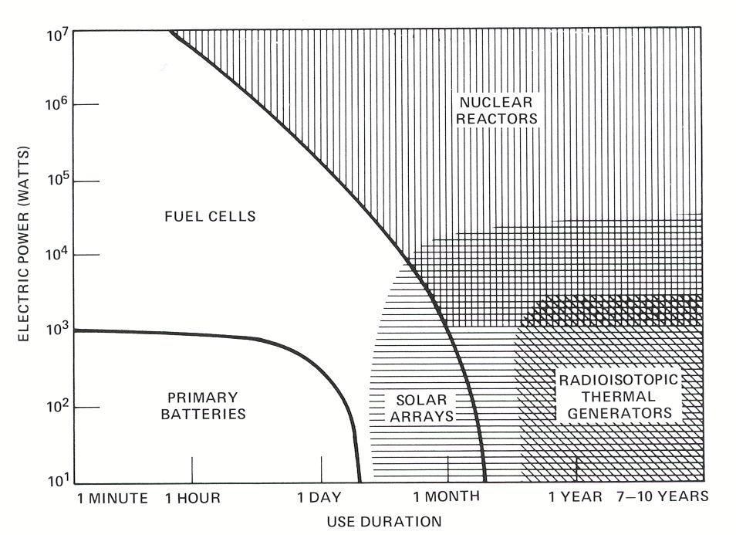
Spacecraft Power Sources
Griffin and French, Space Vehicle Design, Figure 10.2

Slide 9
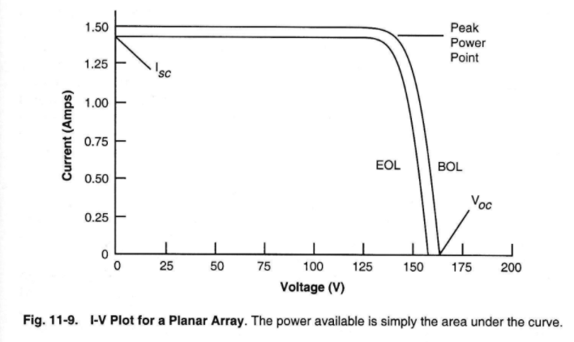
I-V Plot

Slide 10
I-V Plots
Three significant points for solar array design:
Short-circuit current, where voltage = 0
Peak-power point, where voltage times current is maximized
Open-circuit voltage, where current = 0

Slide 11
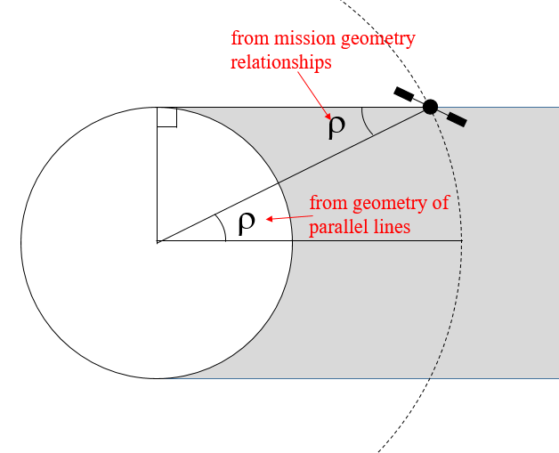
Earth’s Angular Radius

Slide 12
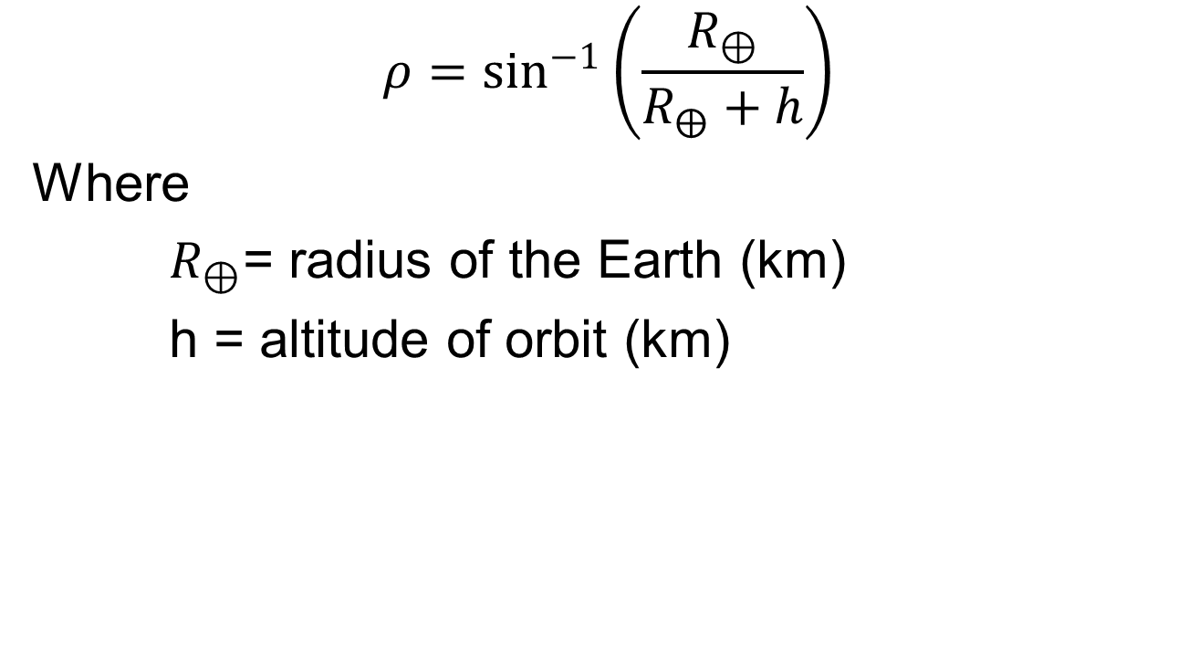
Earth’s Angular Radius
$$ρ=\sin^{−1}\left(\frac{R_{⊕}}{R_{⨁}+h}\right)$$
Where
$R_{⊕}$= radius of the Earth (km)
h = altitude of orbit (km)

Slide 13
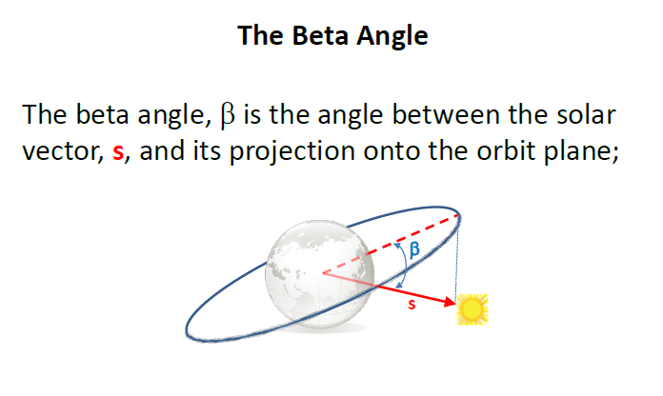

Slide 14
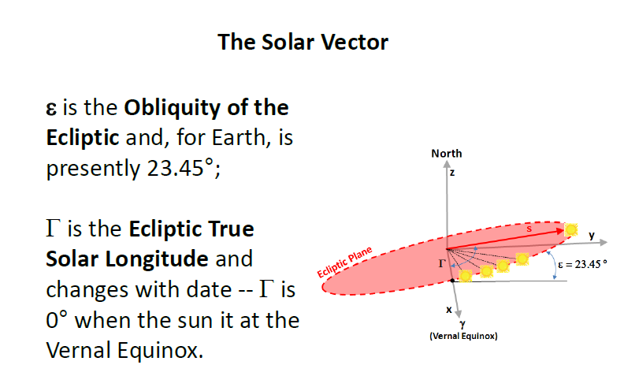

Slide 15
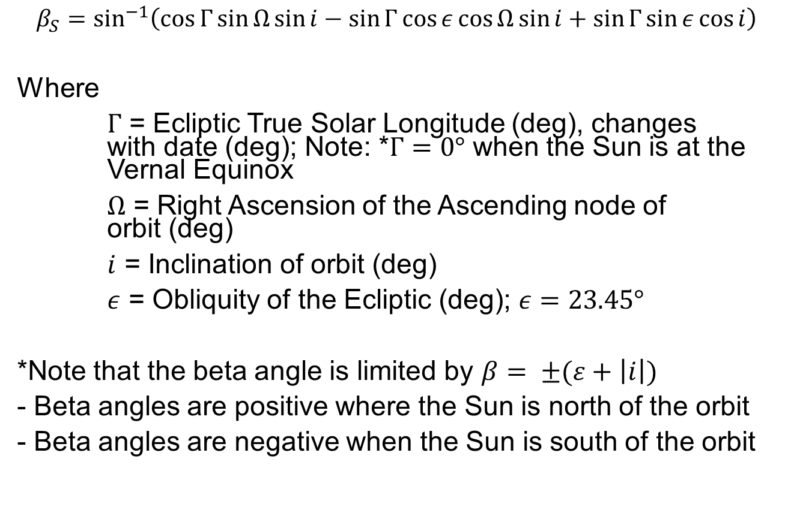
Beta Angle
$$β_{S}=\sin^{−1}\left(\cos{Γ}\sin{Ω\sin{i−\sin{Γ\cos{ε}\cos{Ω\sin{i}+\sin{Γ\sin{ε}\cos{i}}}}}}\right)$$
Where
$Γ$ = Ecliptic True Solar Longitude (deg), changes with date (deg); Note: *$Γ=0°$ when the Sun is at the Vernal Equinox
$Ω$ = Right Ascension of the Ascending node of orbit (deg)
$i$ = Inclination of orbit (deg)
$ε$ = Obliquity of the Ecliptic (deg); $ε=23.45°$
*Note that the beta angle is limited by $β= ±(ε+\left|i\right|)$
- Beta angles are positive where the Sun is north of the orbit
- Beta angles are negative when the Sun is south of the orbit

Slide 16
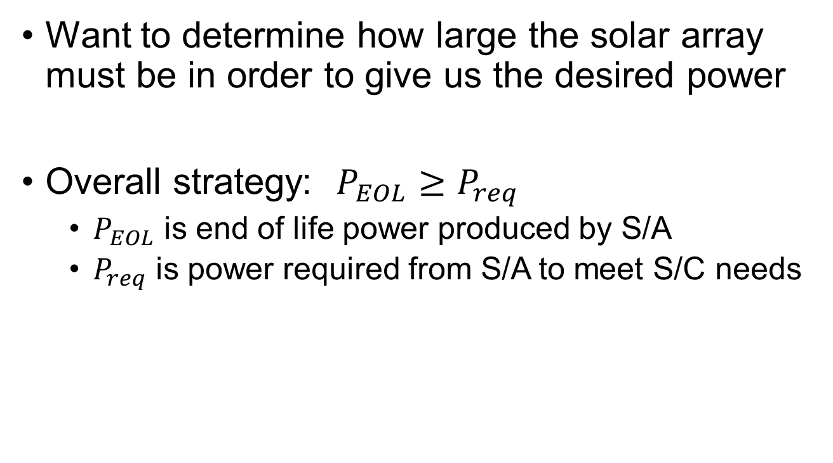
Calculating Solar Array Size
Want to determine how large the solar array must be in order to give us the desired power
Overall strategy: $P_{EOL}≥P_{req}$
$P_{EOL}$ is end of life power produced by S/A
$P_{req}$ is power required from S/A to meet S/C needs

Slide 17
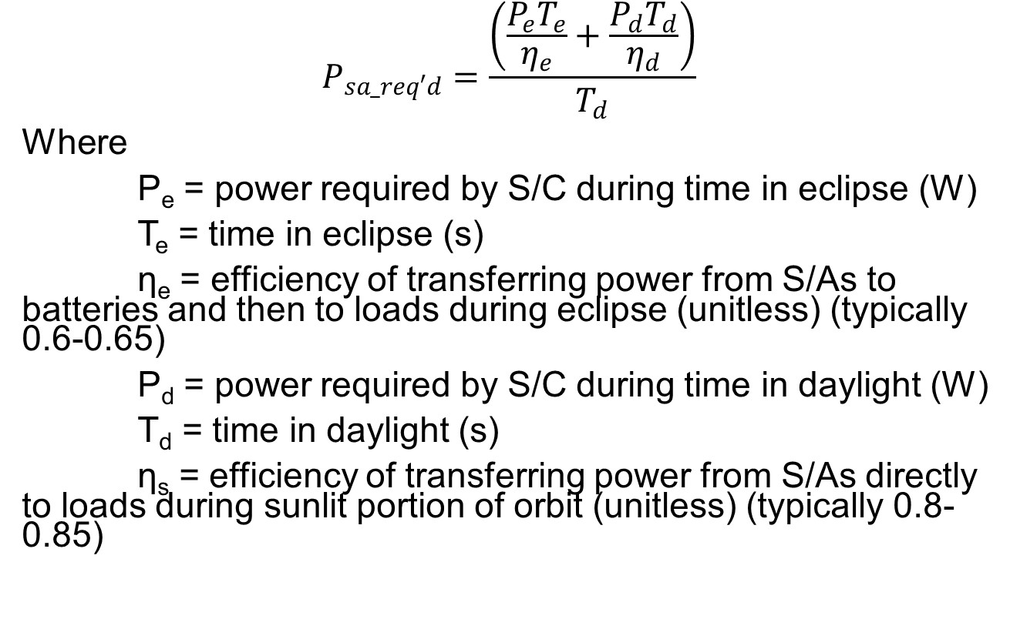
Power Required
$$P_{sa_req′d}=\frac{\left(\frac{P_{e}T_{e}}{η_{e}}+\frac{P_{d}T_{d}}{η_{d}}\right)}{T_{d}}$$
Where
P_{e} = power required by S/C during time in eclipse (W)
T_{e} = time in eclipse (s)
η_{e} = efficiency of transferring power from S/As to batteries and then to loads during eclipse (unitless) (typically 0.6-0.65)
P_{d} = power required by S/C during time in daylight (W)
T_{d} = time in daylight (s)
η_{s} = efficiency of transferring power from S/As directly to loads during sunlit portion of orbit (unitless) (typically 0.8-0.85)

Slide 18
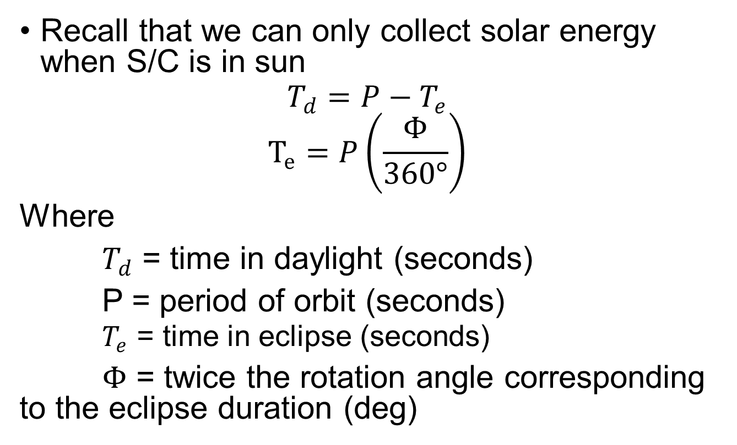
Calculating Time in Daylight
Recall that we can only collect solar energy when S/C is in sun
$$T_{d}=P−T_{e}$$
$$T_{e}=P\left(\frac{Φ}{360°}\right)$$
Where
$T_{d}$ = time in daylight (seconds)
P = period of orbit (seconds)
$T_{e}$ = time in eclipse (seconds)
$Φ$ = twice the rotation angle corresponding to the eclipse duration (deg)

Slide 19
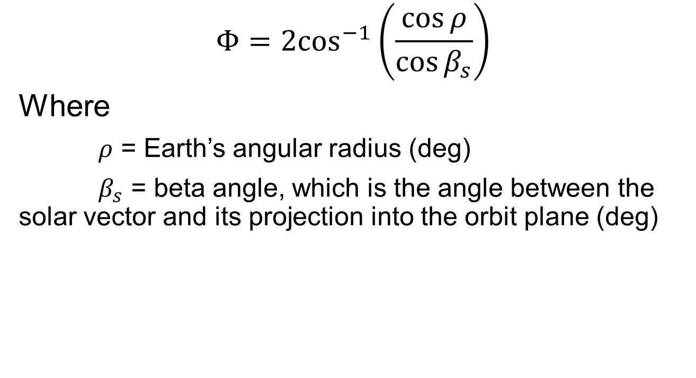
$$Φ{=2\cos^{−1}\left(\frac{\cos{ρ}}{\cos{β_{s}}}\right)}$$
Where
$ρ$ = Earth’s angular radius (deg)
$β_{s}$ = beta angle, which is the angle between the solar vector and its projection into the orbit plane (deg)

Slide 20
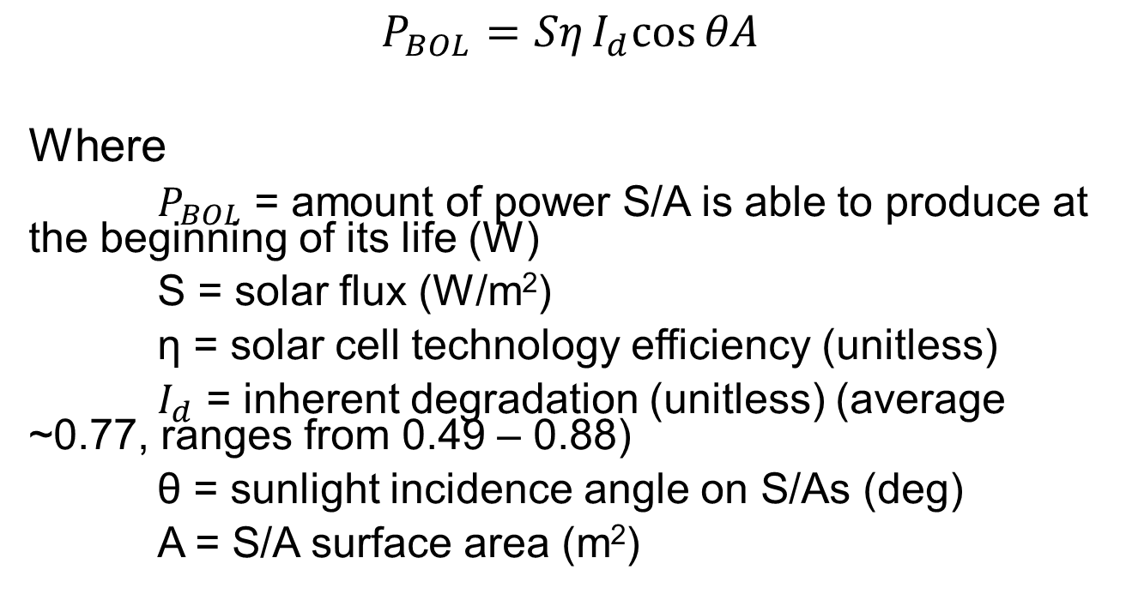
Power at Beginning of Life
$$P_{BOL}=SηI_{d}cos{θA}$$
Where
$P_{BOL}$ = amount of power S/A is able to produce at the beginning of its life (W)
S = solar flux (W/m²)
η = solar cell technology efficiency (unitless)
$I_{d}$ = inherent degradation (unitless) (average ~0.77, ranges from 0.49 – 0.88)
θ = sunlight incidence angle on S/As (deg)
A = S/A surface area (m²)

Slide 21
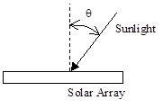
θ = sunlight incidence angle on S/As (deg)
*Note: even sun tracking S/A may not achieve θ = 0 deg under all orbit conditions
(“sun tracking” ≠ 0 deg incidence angle)

Slide 22
Solar Flux
 | Solar Flux (Watt/m²)
Mercury | 9127
Venus | 2615
Earth | 1367
Mars | 589
Jupiter | 50
Saturn | 15
Uranus | 4
Neptune | 2
Pluto | 1

Slide 23
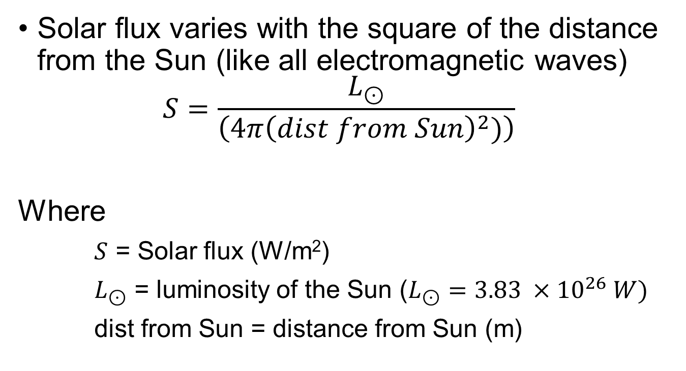
Solar Flux
Solar flux varies with the square of the distance from the Sun (like all electromagnetic waves)
$$S=\frac{L_{⊙}}{\left(4π{\left(dist from Sun\right)}^{2})\right)}$$
Where
$S$ = Solar flux (W/m²)
$L_{⊙}$ = luminosity of the Sun ($L_{⊙}=3.83 ×{10}^{26} W)$
dist from Sun = distance from Sun (m)

Slide 24
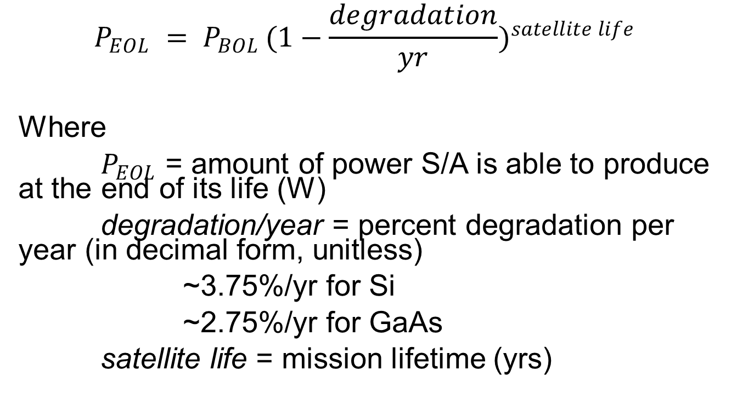
Power at End of Life
$$P_{EOL} = P_{BOL }{(1−\frac{degradation}{yr})}^{satellite life}$$
Where
$P_{EOL}$ = amount of power S/A is able to produce at the end of its life (W)
degradation/year = percent degradation per year (in decimal form, unitless)
~3.75%/yr for Si
~2.75%/yr for GaAs
satellite life = mission lifetime (yrs)

Slide 25
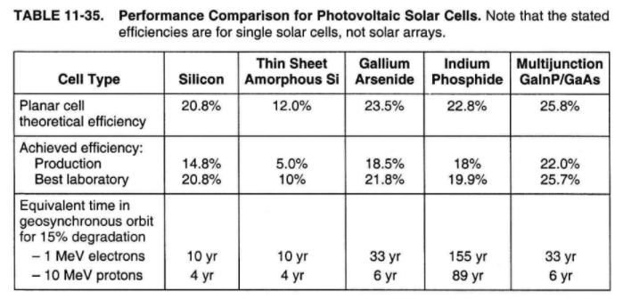
Solar Array Types
Selection of type of solar cells is based on efficiency, degradation, cost, etc.

Slide 26
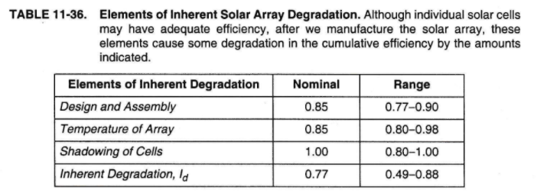
Solar Array Degradation
Solar cells degrade over time due to a variety of factors, which sum to give inherent degradation

Slide 27
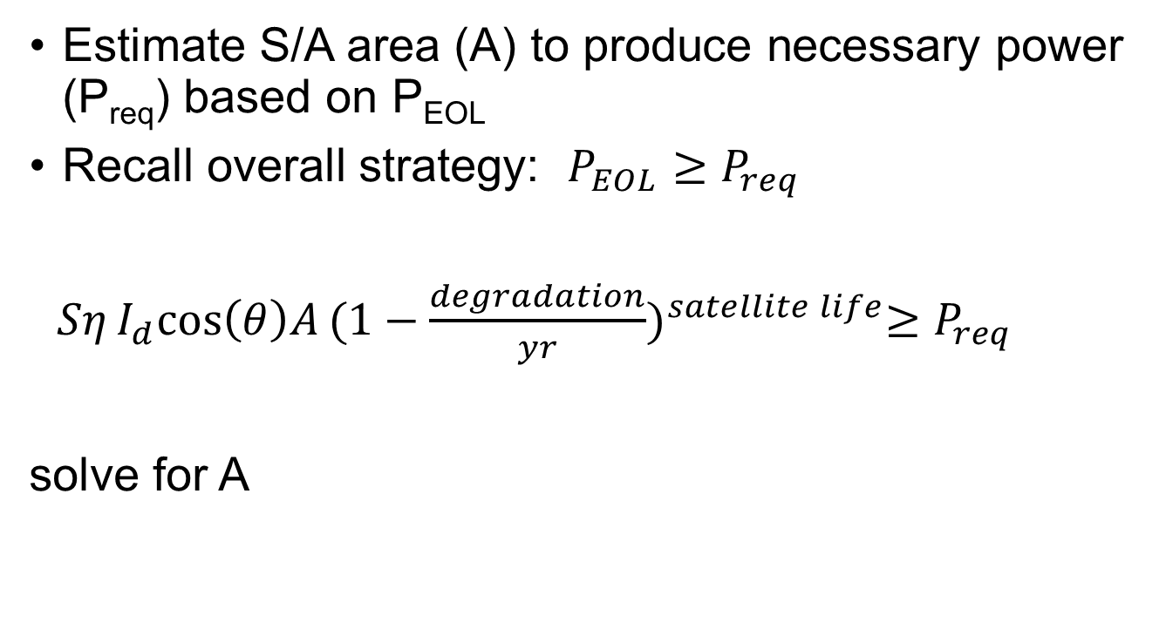
Solar Array Approach
Estimate S/A area (A) to produce necessary power (P_{req}) based on P_{EOL}
Recall overall strategy: $P_{EOL}≥P_{req}$
$SηI_{d}cos\left(θ\right)A{(1−\frac{degradation}{yr})}^{satellite life}≥P_{req}$
solve for A

Slide 28
Energy Storage
necessary to store energy for peak power demands and eclipses
batteries a convenient way to do those (other options: fly wheels, fuel cells)

Slide 29
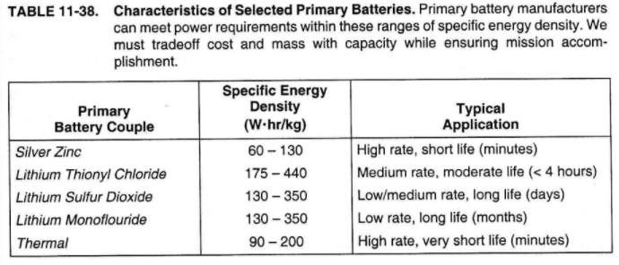
Primary Batteries
Non-rechargeable
High energy densities

Slide 30
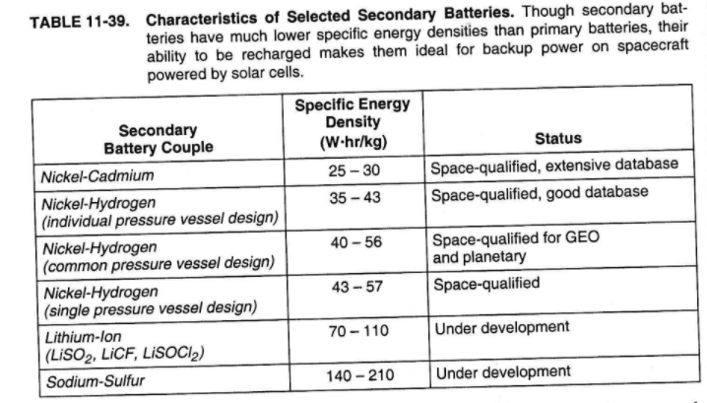
Secondary Batteries
Rechargable, but cycle-life limited
Lower energy densities
Space-qualified

Slide 31
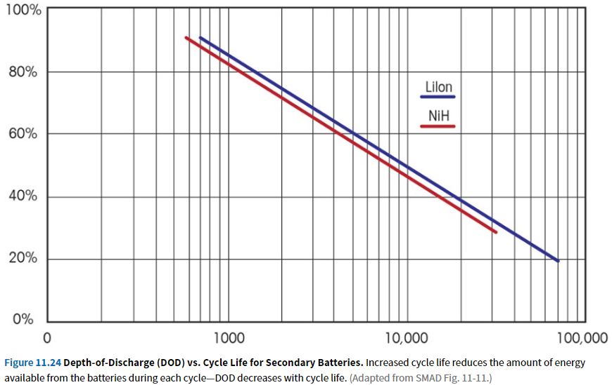
Depth of Discharge
Designing Space Missions and Systems, Figure 11.24

Slide 32
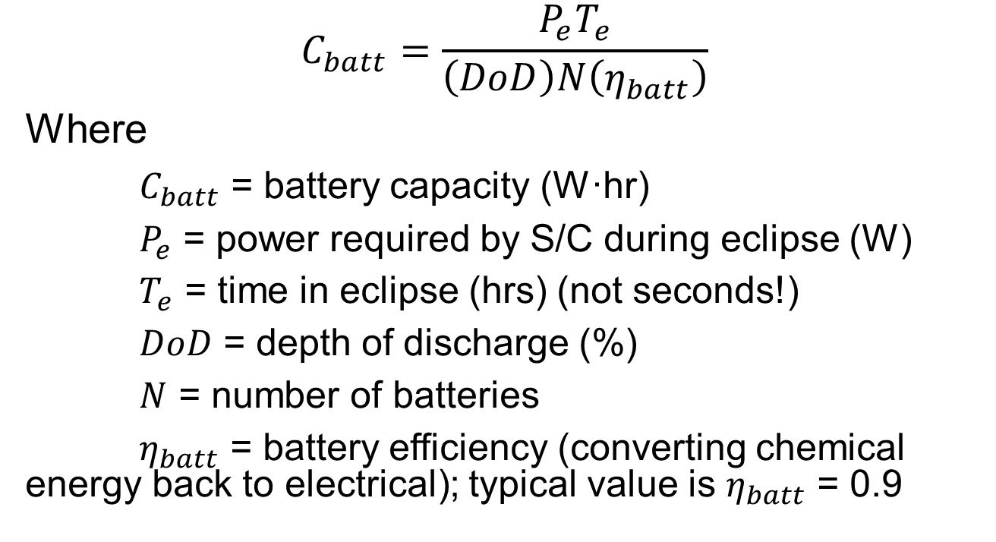
Calculate Battery Size
$$C_{batt}=\frac{P_{e}T_{e}}{\left(DoD\right)N\left(η_{batt}\right)}$$
Where
$C_{batt}$ = battery capacity (W·hr)
$P_{e}$ = power required by S/C during eclipse (W)
$T_{e}$ = time in eclipse (hrs) (not seconds!)
$DoD$ = depth of discharge (%)
$N$ = number of batteries
$η_{batt}$ = battery efficiency (converting chemical energy back to electrical); typical value is $η_{batt}$ = 0.9

Slide 34
Example
Given: A synthetic aperture radar (SAR) satellite on a 5-year mission requires 900W of power at all times. Its COEs are:
a = 7578 km
e = 0
i = 45°
Ω = 30°
ω = 270°
Uses silicon solar cells with 18% efficiency
Efficiency of power transfer in sunlight: 0.85
Efficiency of power transfer in eclipse: 0.65
Inherent degradation of solar cells: 0.75
Worst-case sun incidence angle: 30°
You may assume worst-case beta angle
Find: How big must the solar arrays be in order to provide the required power with a margin factor of 120%? Assume worst-case time in eclipse for your calculations.

Slide 35
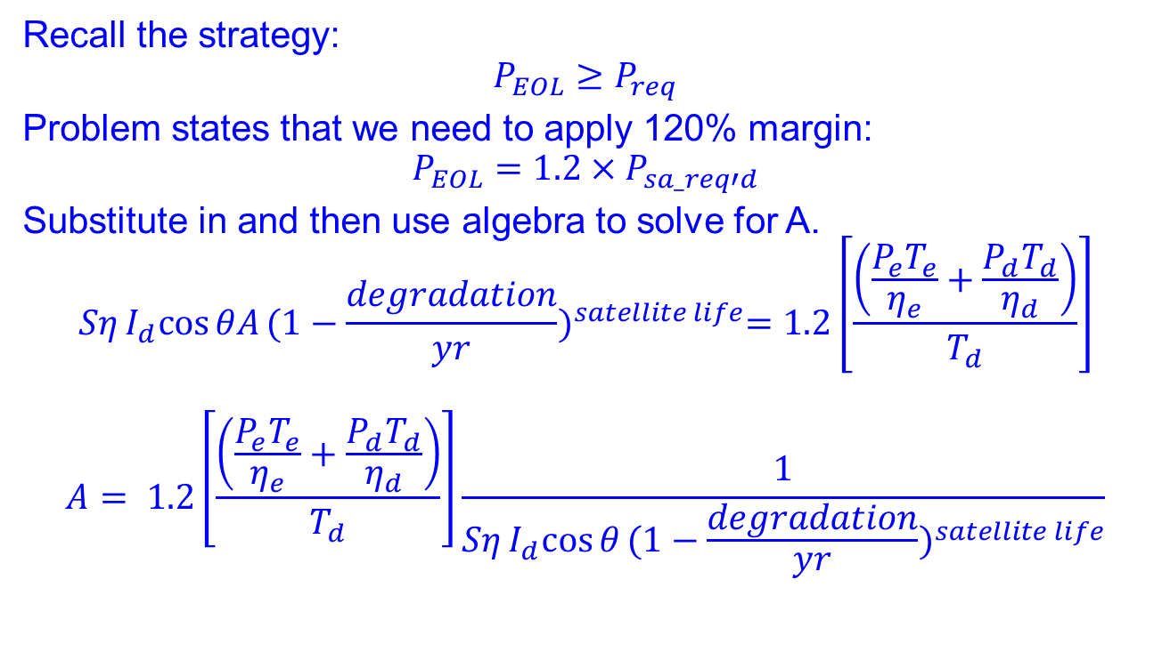
Solution (1/3)
Recall the strategy:
$$P_{EOL}≥P_{req}$$
Problem states that we need to apply 120% margin:
$$P_{EOL}={1.2×P}_{sa_req′d}$$
Substitute in and then use algebra to solve for A.
$$SηI_{d}cos{θA}{(1−\frac{degradation}{yr})}^{satellite life}=1.2\left[\frac{\left(\frac{P_{e}T_{e}}{η_{e}}+\frac{P_{d}T_{d}}{η_{d}}\right)}{T_{d}}\right]$$
$$A= 1.2\left[\frac{\left(\frac{P_{e}T_{e}}{η_{e}}+\frac{P_{d}T_{d}}{η_{d}}\right)}{T_{d}}\right]\frac{1}{SηI_{d}cos{θ}{(1−\frac{degradation}{yr})}^{satellite life}}$$

Slide 36
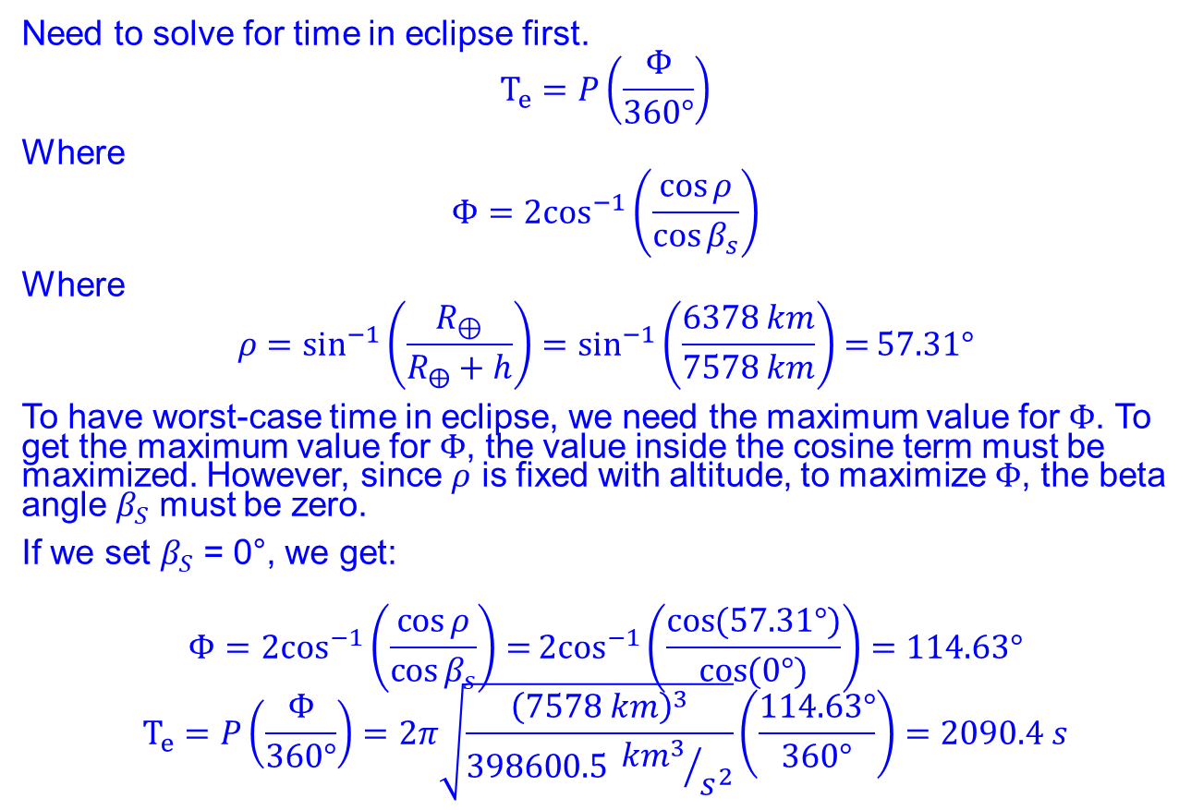
Solution (2/3)
Need to solve for time in eclipse first.
$$T_{e}=P\left(\frac{Φ}{360°}\right)$$
Where
$$Φ{=2\cos^{−1}\left(\frac{\cos{ρ}}{\cos{β_{s}}}\right)}$$
Where
$$ρ=\sin^{−1}\left(\frac{R_{⊕}}{R_{⨁}+h}\right)=\sin^{−1}\left(\frac{6378 km}{7578 km}\right)=57.31°$$
To have worst-case time in eclipse, we need the maximum value for $Φ$. To get the maximum value for $Φ$, the value inside the cosine term must be maximized. However, since $ρ$ is fixed with altitude, to maximize $Φ$, the beta angle $β_{S}$ must be zero.
If we set $β_{S}$ = 0°, we get:
$$Φ{=2\cos^{−1}\left(\frac{\cos{ρ}}{\cos{β_{s}}}\right)=}2\cos^{−1}\left(\frac{\cos{(57.31°})}{\cos{(0°)}}\right)=114.63°$$
$$T_{e}=P\left(\frac{Φ}{360°}\right)=2π\sqrt{\frac{{\left(7578 km\right)}^{3}}{398600.5 {{km}^{3}}/{s^{2}}}}\left(\frac{114.63°}{360°}\right)=2090.4 s$$

Slide 37
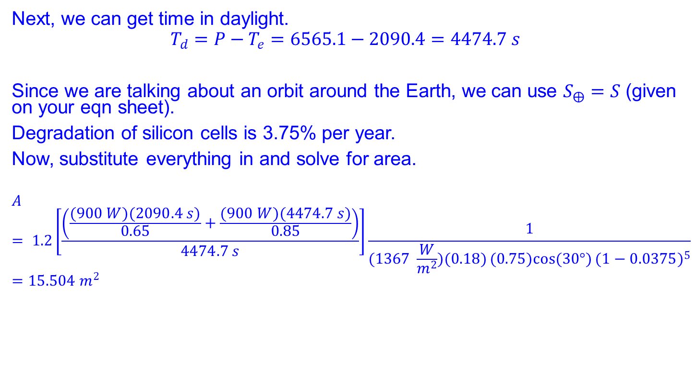
Solution (3/3)
Next, we can get time in daylight.
$$T_{d}=P−T_{e}=6565.1−2090.4=4474.7 s$$
Since we are talking about an orbit around the Earth, we can use $S_{⨁}=S$ (given on your eqn sheet).
Degradation of silicon cells is 3.75% per year.
Now, substitute everything in and solve for area.
$$A= 1.2\left[\frac{\left(\frac{(900 W)(2090.4 s)}{0.65}+\frac{(900 W)(4474.7 s)}{0.85}\right)}{4474.7 s}\right]\frac{1}{(1367 \frac{W}{m^{2}})(0.18)(0.75)cos{(30°)}{(1−0.0375)}^{5}}=15.504 m^{2}$$

